Slide 1
Behavioural Finance
11. How to apply behavioural insights in public policy III
Antonio Silva, May 2023

Slide 2
Behavioural insights project simulation
Each individual/group will work to apply behavioural insights to a real challenge and come up with a behaviourally-informed solution to that challenge
Pick a behaviour to focus on (this can be the topic of your essay)
Your ideas should be:
Feasible (can your idea be implemented?)
Impactful (will it have a social impact?)

Slide 3
Solution phase
TARGET
EXPLORE
SOLUTION
TRIAL
SCALE
Phases
Apply insights from behavioural science to generate
solutions that will encourage the target behaviour.
Notes:
PURPOSE:
Introduce Solution phase of methodology.
KEY MESSAGES:
In the solution stage we develop the policy or an intervention to change the target behavior.
We do that by drawing from the insights of explore phase and from behavior change frameworks.
TIMING:
30 seconds

Slide 4
Analyse the types of intervention available
Notes:
PURPOSE:
The next step in the methodology is the identify who contributes to this goal and what specific behaviours contribute to the success or failure of the goal - what behaviours produce the outcome we want to see
Line up audience for next few slides which go through why we focus on behaviours
KEY MESSAGE:
Now that we have the high level goal we’re going to work on we need to identify who contributes to this goal and what specific behaviours contribute to the success or failure of the goal.
TIMING:
30 seconds
LINK:
To next slide

Slide 5
What types of intervention are available to you?
Some key interventions where a behavioural insights approach can be applied.
Information Provision
Environment Design
Process Design
Incentives
Systemic Rules
Can you change the information provided to tell people how to perform a behaviour or why they should perform a behaviour?
Can you redesign the environment in which decisions are made or space in which activities are completed?
Can you redesign the process people have to follow to perform a behaviour?
Can you change the costs or benefits that incentivise or motivate a behaviour?
Can you change the fundamental rules that govern the behaviour, such as regulations, laws, or policies?
© The Behavioural Insights Team
Notes:
PURPOSE:
Explain the different interventions where you can apply a BI approach
KEY MESSAGE:
These interventions are not exhaustive but a useful starting point.
TIMING:
2 min
LINK:
To next slide

Slide 6
How can behavioural insights enhance these interventions?
Some examples of how a behavioural insights approach can be applied to these interventions.
Information Provision
Environment Design
Process Design
Incentives
Systemic Rules
Framing
Social norms
Influential messengers
Salience
Choice Architecture
Habit Forming Environments
Removing Friction
Simplifying
Peak-End-Effect
Primacy / Recency Effect
Non-financial rewards
Group Incentives
Timing of Incentives
Public signals of success
Progression charts
Defaults
Regulation
Legislation
© The Behavioural Insights Team
Notes:
PURPOSE:
Explain examples of how BI can improve the effectiveness of these interventions
KEY MESSAGE:
Information Provision
Framing - many tax authorities around the world have run experiments have shown that changing the presentation of forms or reminder letters can substantially increase tax compliance. These changes might involve introducing new information, such as stating that the recipient is in the minority of people who have not paid; or they can focus on making existing information clearer, like clarifying exactly what someone is required to do in a particular situation
Messenger affect - A series of studies in the US compared the effect of a motivational message from a beneficiary of a worker’s efforts to the same message from their team leader. These studies consistently find that, when emphasizing the positive impact of a task, beneficiaries are significantly more effective than leaders when it comes to improving productivity and performance
Environment
Employees in a Chinese textile factory were in the habit of throwing waste scraps of cloth on the floor next to them, creating a slipping hazard. Workers were financially motivated to continue working without breaks. Researchers partnering with the factory thought that meaningful visual cues on the floor might help change behavior. They introduced decals depicting golden coins on the production floors. Culturally, golden coins are considered an omen for fortune and luck, meaning the employees would have a disincentive to cover them. Following a five month period of experimentation, waste on the floor had reduced by over 20%. A small, contextually meaningful, tweak to the design of the environment was enough to overcome a seemingly entrenched habit.
Process
Peak-end-effect - In the medical domain there is a received wisdom that it’s “better to get it over with”. This ethos, coupled with efficiency considerations for hospital services, mean that speed is often implicitly valued in medical procedures, especially where pain is involved. In Toronto, 1995, a team of physicians and academics were grappling with a very specific research problem: decreasing pain perception among colonoscopy patients. Their research hinged on a phenomenon known as the “peak-end rule”. This rule states that our judgment and memory is disproportionately shaped by the peak moment and the very last part of an experience. Since colonoscopies at the time typically conformed to the notion of “better to get it over with”, they inevitably induced significant discomfort in the final moments. A slower “exit”, the team hypothesized, would be perceived as less unpleasant, even though it would make for a longer procedure. The insight proved correct: patients whose colonoscopies involved an additional three minutes of slow extraction rated their overall pain to be lower and had a more favorable view of the experience.
Incentives
Non financial incentives - In Zambia researchers recruited hairdressers (influential messengers) to sell female condoms. Tested monetary and non-monetary rewards - 90% commission, 10% commission and non financial incentive (public signals of success and progression charts). While the financial incentives were no more effective overall than the control, over the course of a year the sellers with the star chart sold around double the number of condoms. The results of this experiment show that applying behavioral insights to incentives, such as incorporating public signals of success and outcome-oriented progression charts, can increase motivation in low-resource environments, even out-performing traditional financial incentives.
Group incentives - giving financial rewards for group outcomes resulted in greater healthy weight loss compared with rewarding individual performance: the added motivation to not let down a teammate supercharged the promise of financial gain
Rules
Defaults- Switching to a greener household energy tariff is one way that most of us could reduce our carbon emissions. Traditional approaches to increasing switching usually involve giving us more information to influence our decision. In Germany, in the late 1990s, an energy company in the south broadened its service to include three tariffs: the cheapest, the least environmentally friendly one; a mid-priced but greener tariff; and a more expensive, and even more eco-friendly, tariff. Since customers had to be on one of the three tariffs, the starting point - the pre-selected default - was the middle option; customers could switch to go greener or cheaper if they wanted. After 2 months, 94% of customers stuck with the default tariff, with the effect of automatically flipping most of a market to a greener alternative overnight. Just 4.3% went with the cheaper option, 1% chose the greenest but more expensive tariff, and 0.7% of customers switched to another supplier.
It is not just consumers who are influenced by defaults: 80% of countries accept treaty adjudication by the International Court of Justice when it is the default option, compared with only 5% when the country has to actively choose it.
TIMING:
2 min
LINK:
To next slide
REFERENCES
Ashraf, N., Bandiera, O. and Jack, B.K., 2014. No margin, no mission? A field experiment on incentives for public service delivery. Journal of Public Economics, 120, pp.1-17.
Grant, Adam M., and David A. Hofmann. "Outsourcing inspiration: The performance effects of ideological messages from leaders and beneficiaries." Organizational Behavior and Human Decision Processes 116, no. 2 (2011): 173-187.
Wu, Sherry Jueyu, and Elizabeth Levy Paluck. "Designing nudges for the context: Golden coin decals nudge workplace behavior in China." Organizational Behavior and Human Decision Processes (2018).
Redelmeier, Donald A., Joel Katz, and Daniel Kahneman. "Memories of colonoscopy: a randomized trial." Pain 104, no. 1-2 (2003): 187-194.
Pichert, Daniel, and Konstantinos V. Katsikopoulos. "Green defaults: Information presentation and pro-environmental behaviour." Journal of Environmental Psychology 28, no. 1 (2008): 63-73.

Slide 7
Intervention considerations
Consider which intervention will be most effective for the behaviours you want to change.
Information Provision
Environment Design
Process Design
Incentives
Systemic Rules
Are information campaigns having the desired effect?
Who does the end user listen to?
What channels are available?
Is the environment conducive to the behaviour?
What barriers in the environment are preventing the target behaviour?
Are existing processes having the desired results?
Is there friction in the process?
Are the incentives aligned?
Can the behaviour be changed without enforcing rules?
© The Behavioural Insights Team
Notes:
PURPOSE:
Explain the factors to consider when assessing which intervention to use.
KEY MESSAGE:
For each intervention there are a number of factors to consider.
Real examples
TIMING:
2 min

Slide 8
Apply behavioural insights to generate solutions
Notes:
PURPOSE:
The next step in the methodology is the identify who contributes to this goal and what specific behaviours contribute to the success or failure of the goal - what behaviours produce the outcome we want to see
Line up audience for next few slides which go through why we focus on behaviours
KEY MESSAGE:
Now that we have the high level goal we’re going to work on we need to identify who contributes to this goal and what specific behaviours contribute to the success or failure of the goal.
TIMING:
30 seconds
LINK:
To next slide

Slide 9
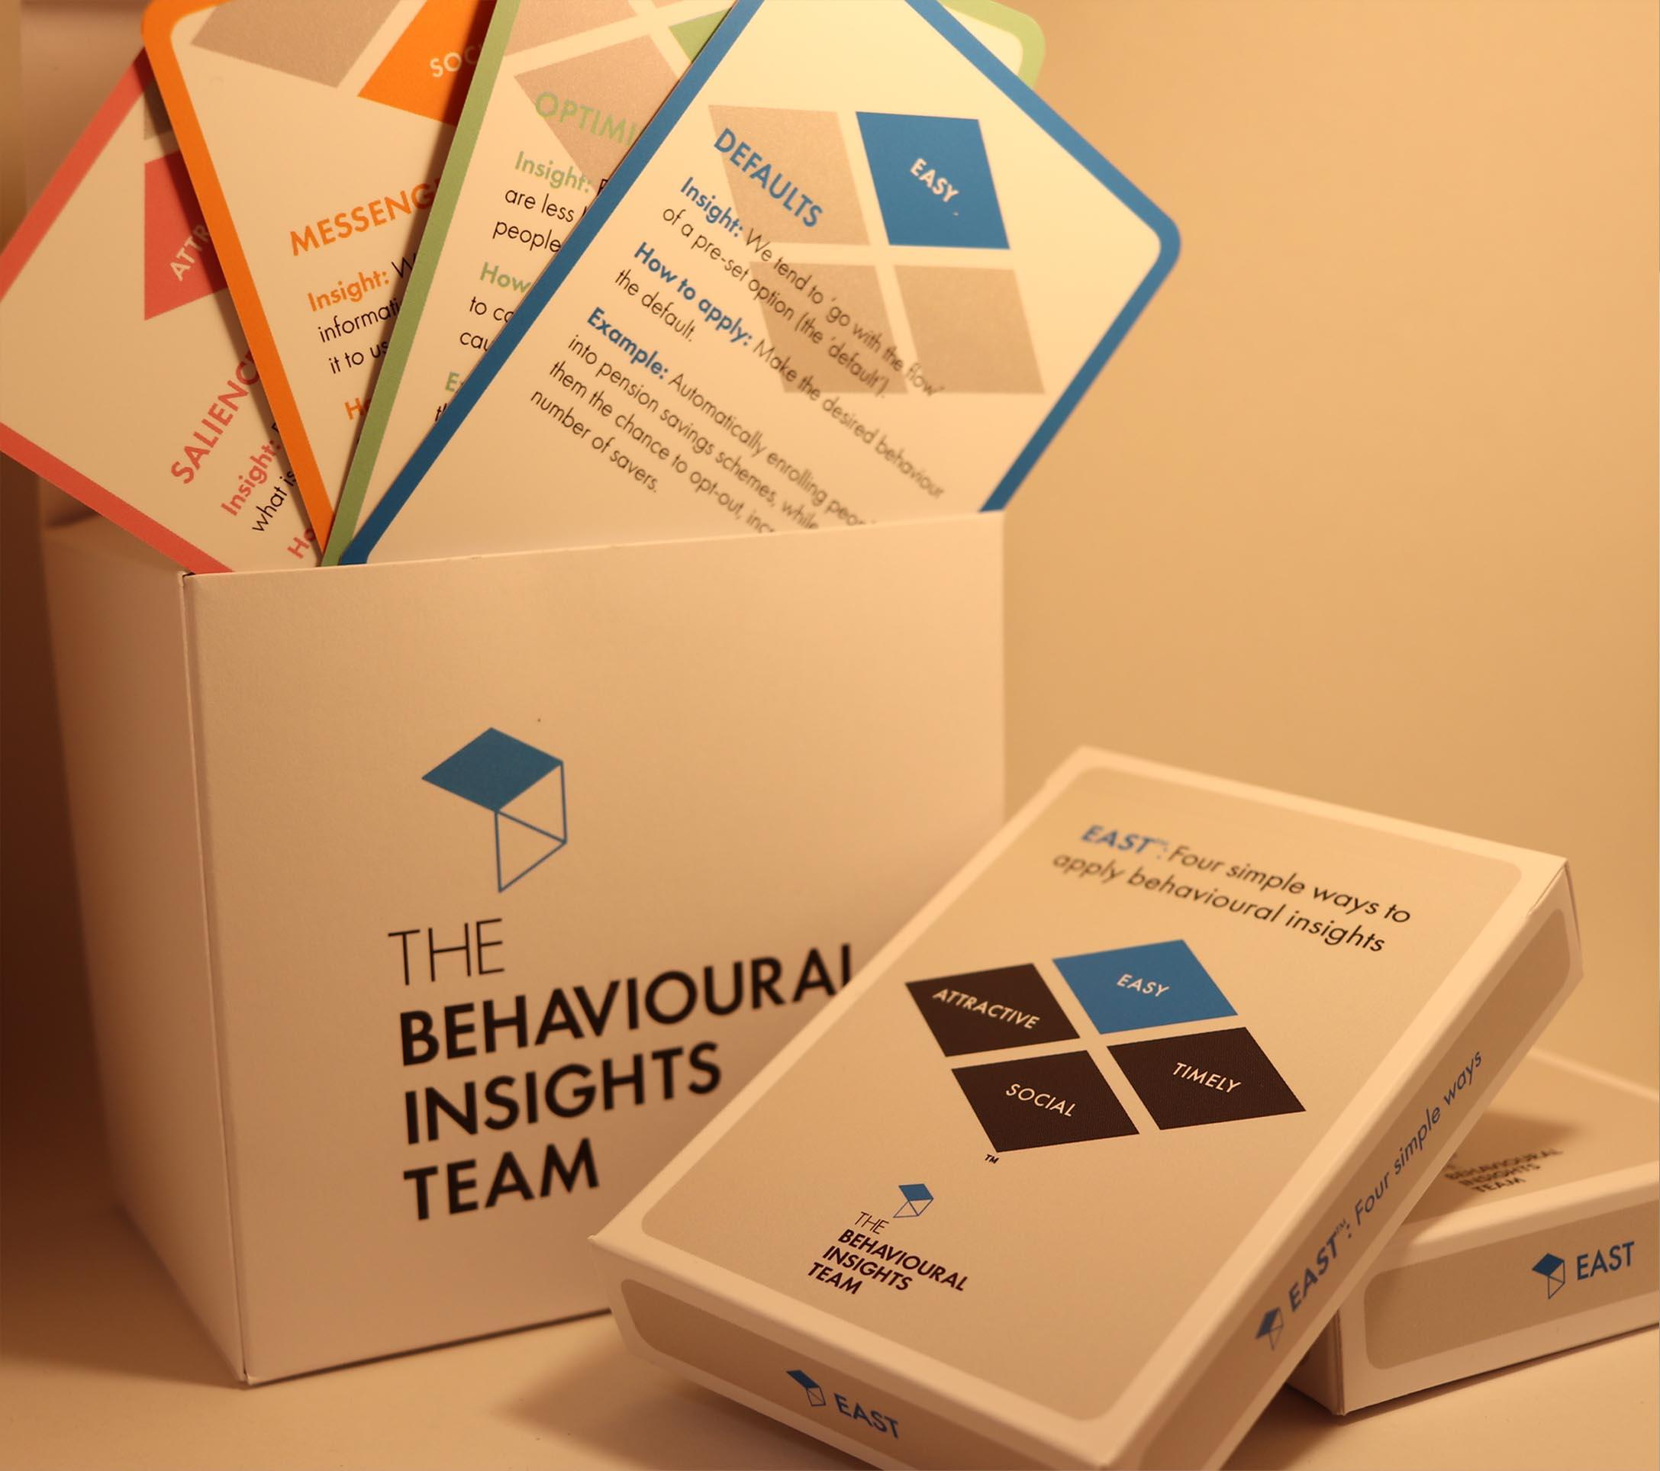
EAST Cards to generate solutions
EAST Cards: A set of practical cards that explain core principles from behavioural science and how to apply these principles to policy challenges.
These cards enable new practitioners to quickly understand and apply behavioural insights.
You can also access them online
Each card outlines;
1 behavioural insight
Guidelines for how to apply this insight to solve a challenge
An example
Notes:
PURPOSE:
Introduce EAST cards and game.
KEY MESSAGES:
You’re now going to use our EAST cards to generate behavioural solutions.
Our EAST cards have been designed based on our EAST framework to support practitioners to come up with new ways to apply behavioural insights.Each card outlines one behavioural insight, guidelines for how to apply this insight to solve a behavioural challenge and a worked example.
These EAST cards are based on our EAST framework and contain 39 behavioural insights condensed into 1 neat card pack that can be used to help support new practitioners in generating behavioural insights solutions. Each card falls under one of the 4 EAST components.
In a few moments you will use these cards to design behavioural interventions. We have created a digital tool for you to use online
But first, I want to go through a few things to structure this exercise”
HOW TO DO IT:
You’ll hand out packs of cards. Demonstrate the game (5 min) and then give the audience time to play (45 min).
TIMING:
1 min

